Slide 1
W1_D3 - ANN
Sivasankar Arul

Slide 2
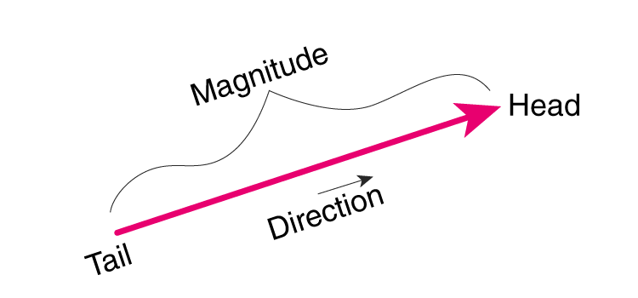
Vectors - understanding it
2. Examples in Everyday Life
Vectors show up in many common situations: - Wind: If someone says the wind is blowing 20 km/h to the east, that’s a vector: it has both speed (20 km/h) and direction (east). - Walking: If you walk 5 meters north, that’s also a vector: the distance (5 meters) and the direction (north) together form the vector.
1. A Vector is Like a Directed Arrow
Imagine you are standing in a park, and I ask you to walk in a specific direction for a certain distance: Direction: I might point towards a tree. Distance: I might tell you to walk 10 steps. This combination of direction and distance is what a vector represents. You can think of it as an arrow: - The arrow points in the direction you should walk. - The length of the arrow represents how far you should walk. So, a vector has two important things: - Magnitude (the length of the arrow) – how far. - Direction (which way the arrow is pointing) – where to go.

Slide 3
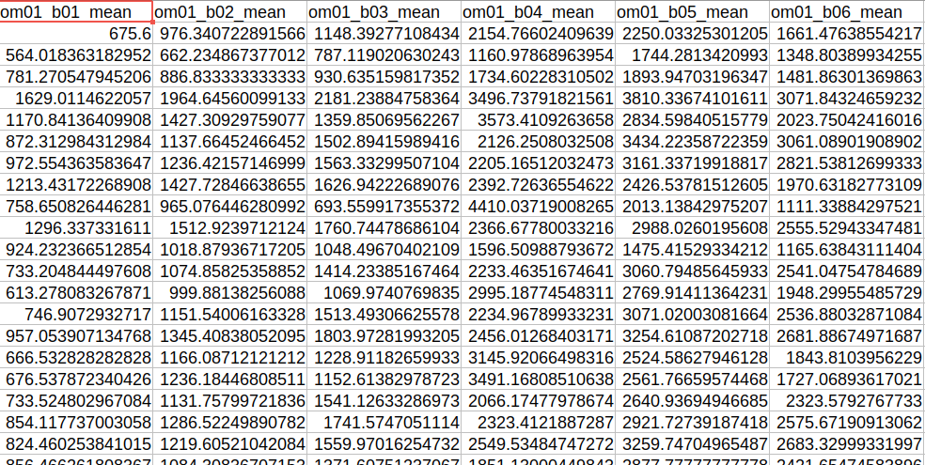
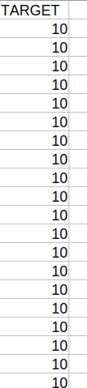
Recap
What you have-
Data as a table:
1 column of target class
N columns of data describing the target class - also called features
What do with it?
You have ML models based on linear algebra (SVM) and decision tree principles (RF)
Train ML models and use for prediction.
features

Slide 4
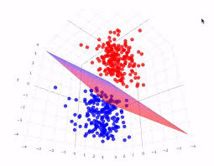
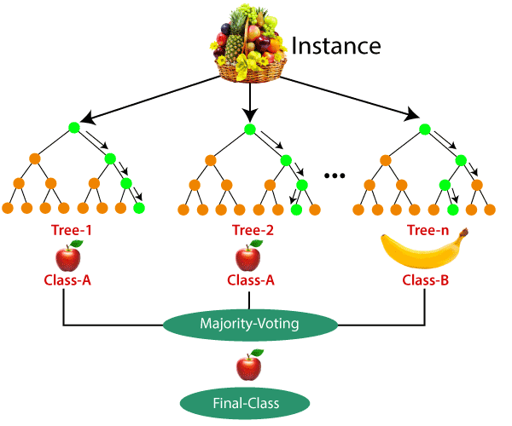
ML models
Trained model for prediction
based on linear algebra (SVM)
decision tree principles (RF)

Slide 5
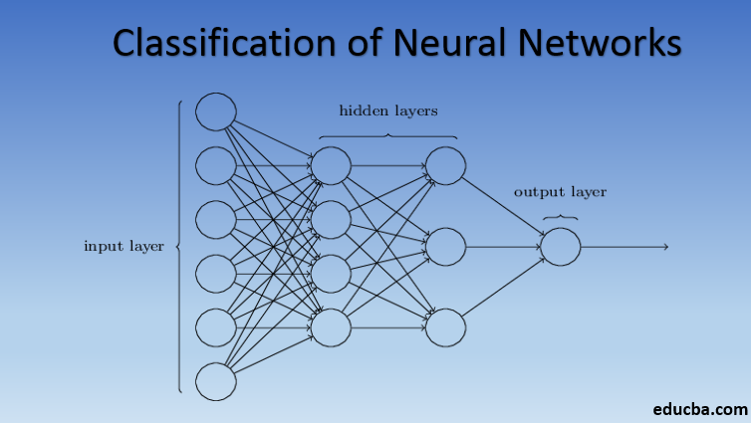
NN neural network
ML models
Trained model for prediction
Model based on Neural network

Slide 6
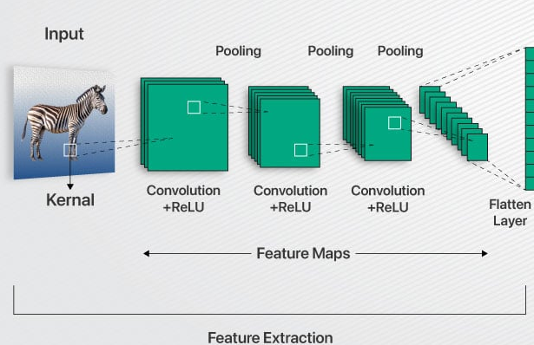
CNN - convolution neural network
ML models
Trained model for prediction
Model based on Neural network
convolution

Slide 7
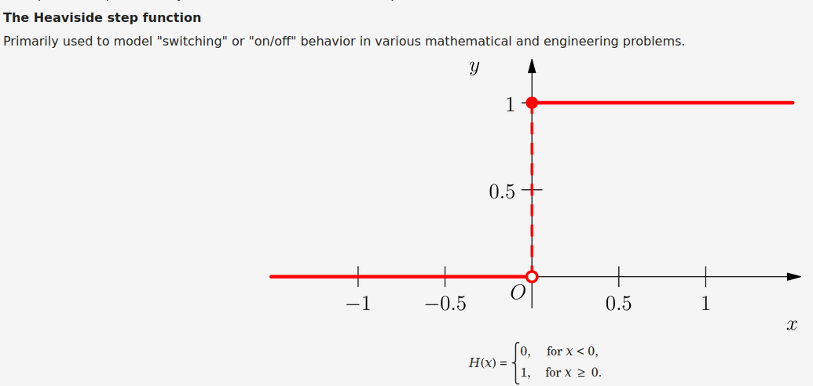
Precursor - Heavy side step function

Slide 8
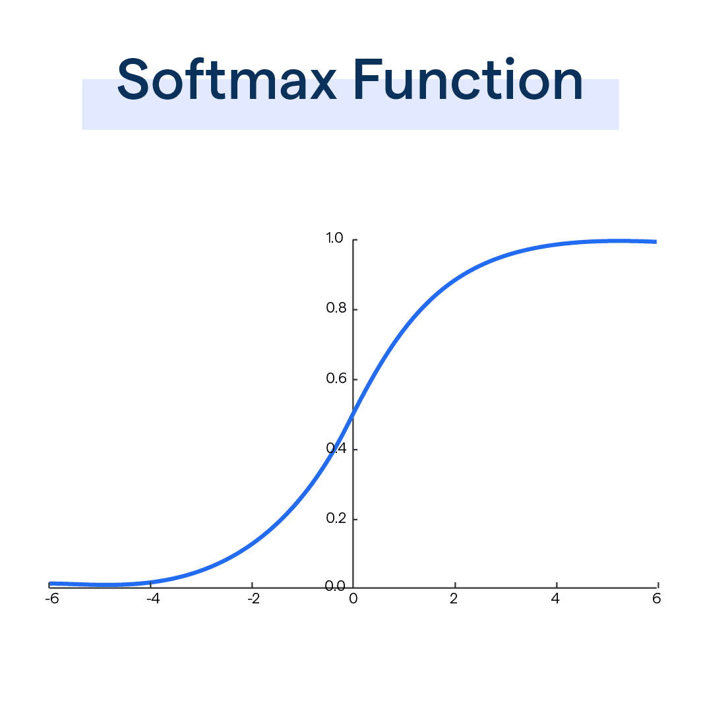
Precursor - Soft-max step function

Slide 9
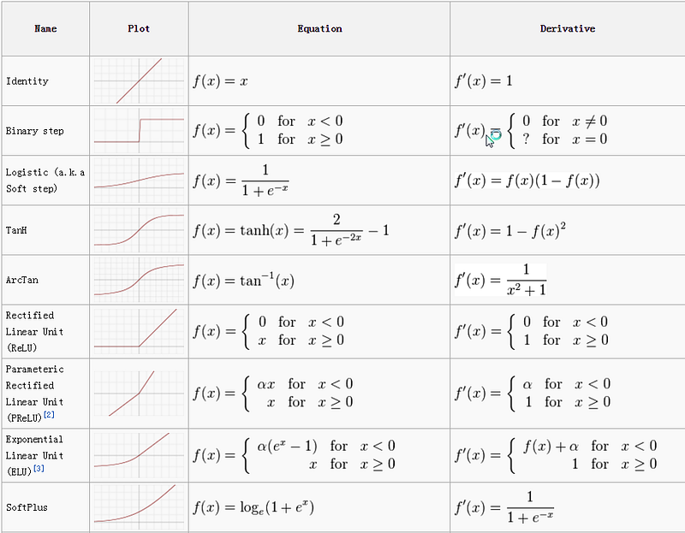
Precursor - Other functions

Slide 10
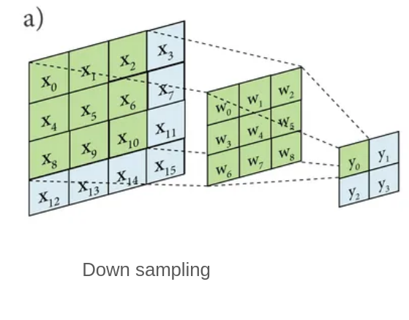
Precursor - Convolution

Slide 11
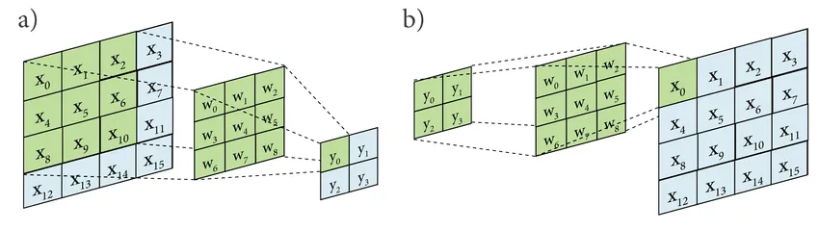
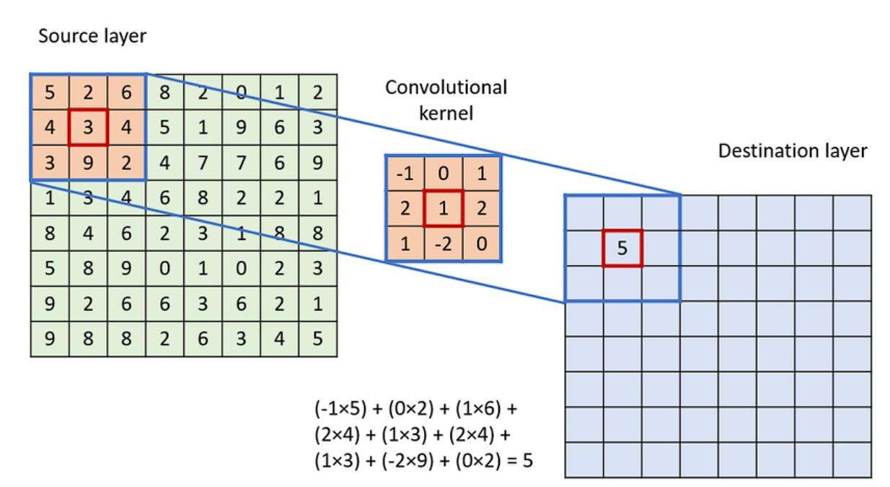
Precursor - Convolution
Down sampling
Up sampling
https://towardsdatascience.com/types-of-convolutions-in-deep-learning-717013397f4d

Slide 12
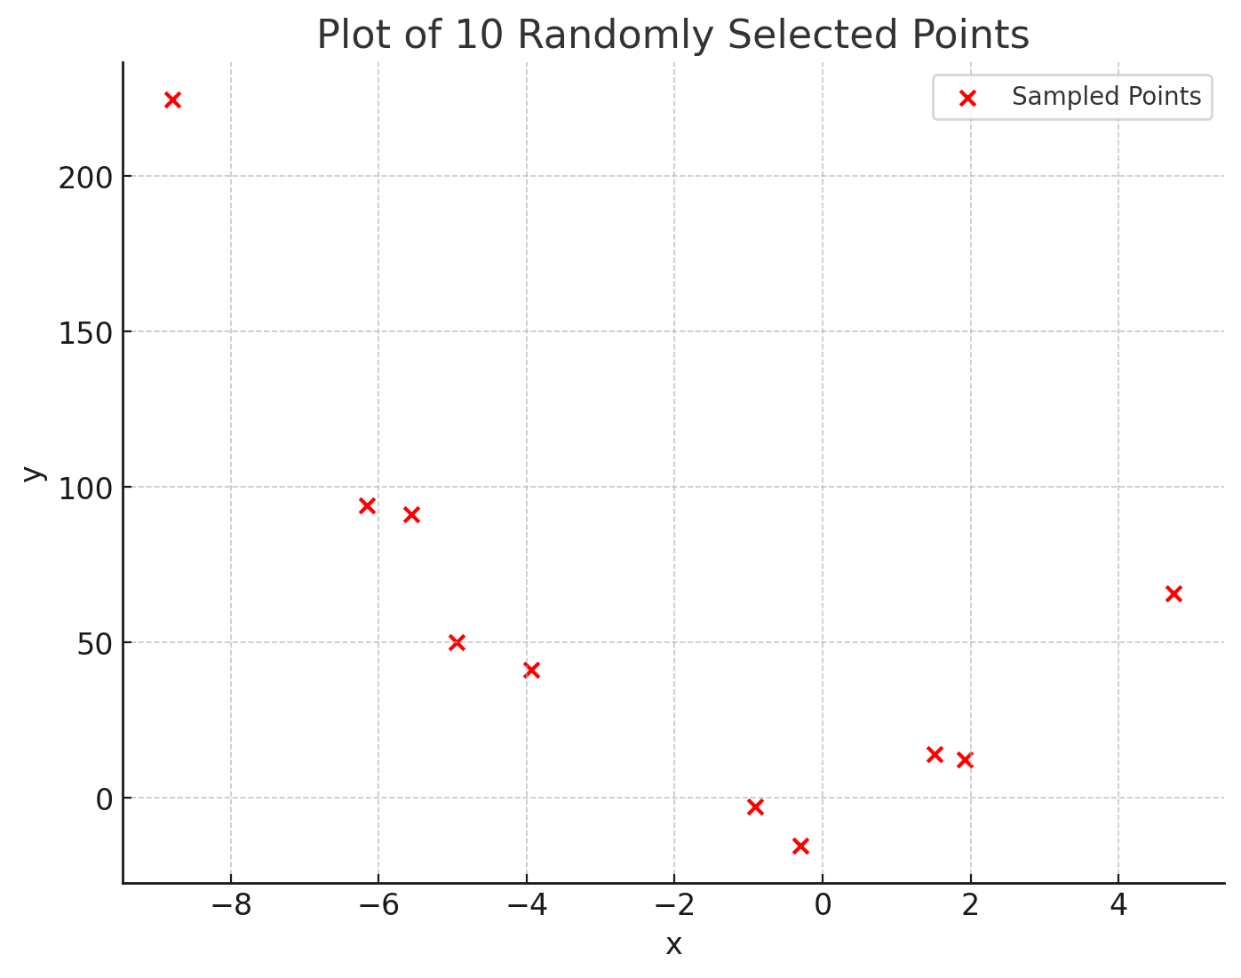
Gradient descent
Data
x | y
Function
Loss function

Slide 13
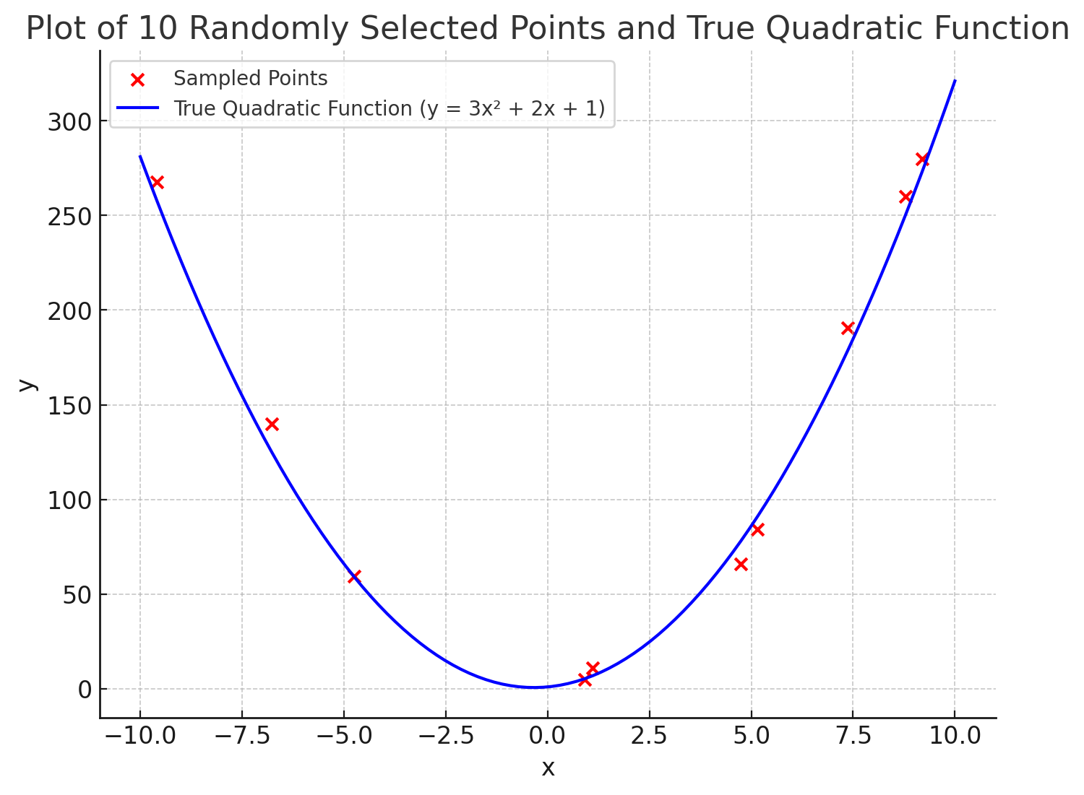
Gradient descent
Data
x | y
Function
Loss function

Slide 14
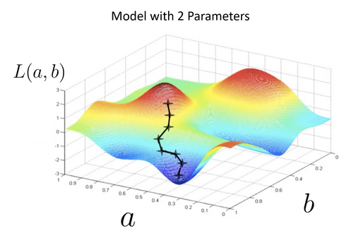
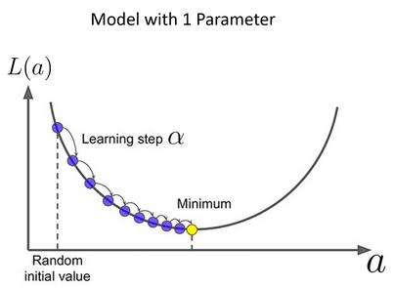
Gradient descent

Slide 15
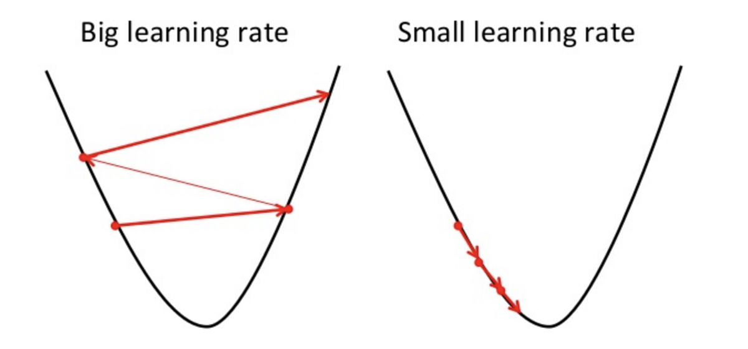
Gradient descent - common issues
Learning rate

Slide 16
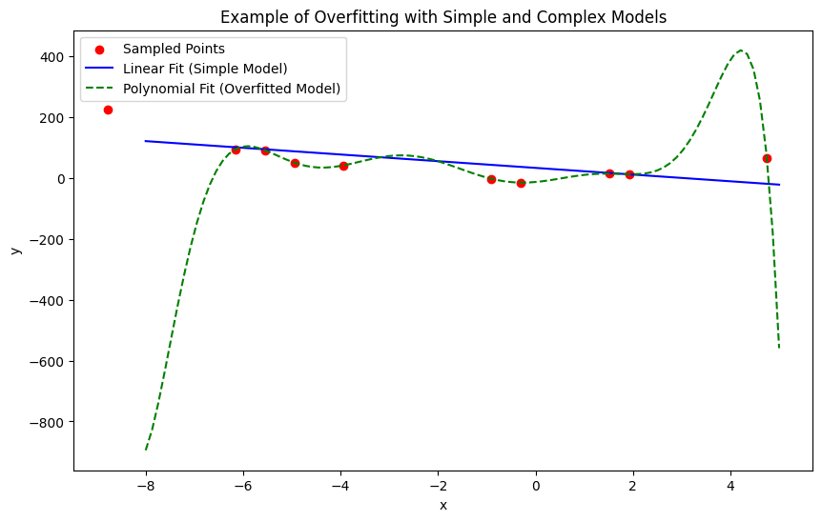
Gradient descent - common issues
Overfitting

Slide 17
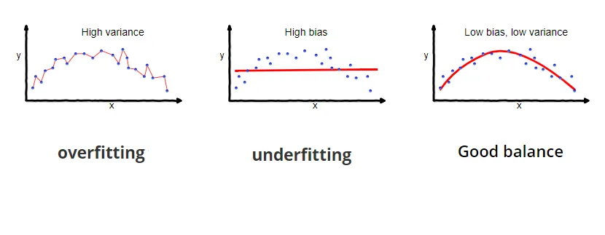
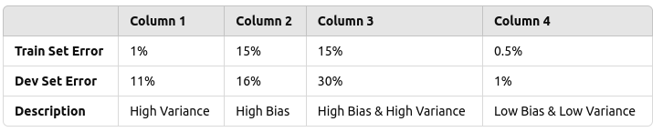
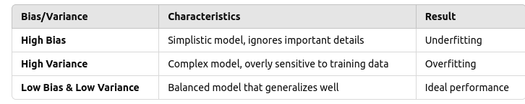
Bias vs Variance
Bias
errors
overly simplistic assumptions in the model
High bias -> not capturing complexity -> underfitting
Variance
model's sensitivity to small fluctuations in the training data
model is too complex, capturing even the noise in the data, which leads to overfitting
This is known as the bias-variance tradeoff.
Low Bias & Low Variance: The ideal scenario. The model is accurate and generalizes well.
High Bias & Low Variance: The model is too simple (underfitting).
Low Bias & High Variance: The model is too complex (overfitting).
High Bias & High Variance: Rare but possible. The model is both too simple and unstable.

Slide 18
Bias vs Variance
To reduce bias:
more features,
add complexity to the model (e.g., more layers in a neural network), or
try a more complex model.
To reduce variance:
Simplify the model,
collect more data,
use regularization techniques (like dropout in neural networks), or
try ensemble methods like bagging.

Slide 19
Bias
To reduce bias:
more features,
add complexity to the model (e.g., more layers in a neural network), or
try a more complex model.
Regression Models: add more features -> including more variables
SVMs: more features can help improve the decision boundary
feature selection or feature engineering is critical. Choosing features that are genuinely related to the target variable can improve the model’s generalization
To reduce bias:
more features,
add complexity to the model (e.g., more layers in a neural network), or
try a more complex model.
Regression Models: using polynomial or interaction terms
SVMs: using non-linear kernels like radial basis function (RBF) or polynomial kernels
feature selection or feature engineering is critical. Choosing features that are genuinely related to the target variable can improve the model’s generalization

Slide 20
Variance - regularization
adding a penalty
reduce variance and helps prevent overfitting
L2 Regularization
adds a penalty based on sum( weights squared)
Reduces large weights -> makes simpler model
parameter : alpha, lambda
L1 Regularization
adds a penalty based on the sum of the absolute values of the model parameters
some weights are set to zero
ignoring some features

Slide 21
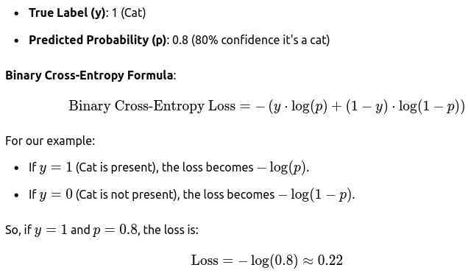
Loss function
Binary Cross-Entropy
Binary classification tasks (two classes), e.g., predicting if an image contains a cat (1) or not (0).
During training, the neural network tries to minimize this loss
if the network predicts 0.8 but the actual label is 1, it will adjust the weights to increase the output closer to 1
If the prediction is too far off, the loss will be higher, and the weights will adjust more significantly in the direction that decreases the loss

Slide 22
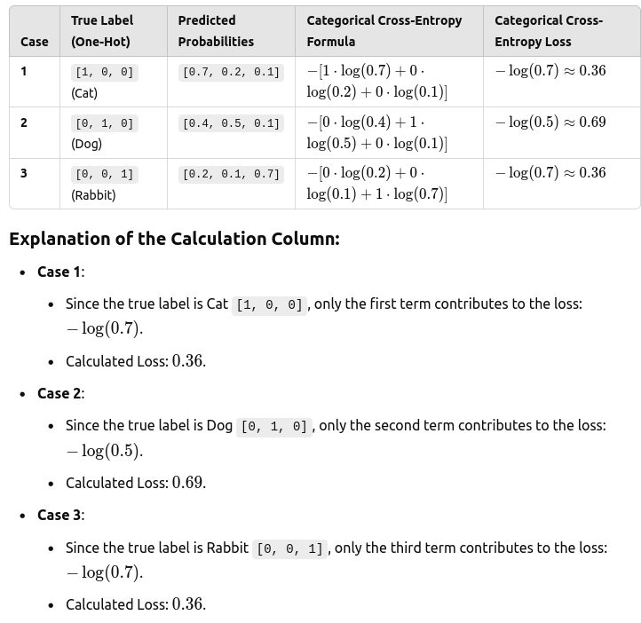
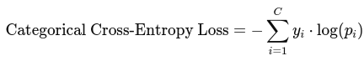
Loss function
The categorical cross-entropy formula focuses only on the predicted probability of the true class.
The other terms are multiplied by zero and do not affect the loss.
This way, the model learns to increase the probability of the correct class during training.

Slide 23
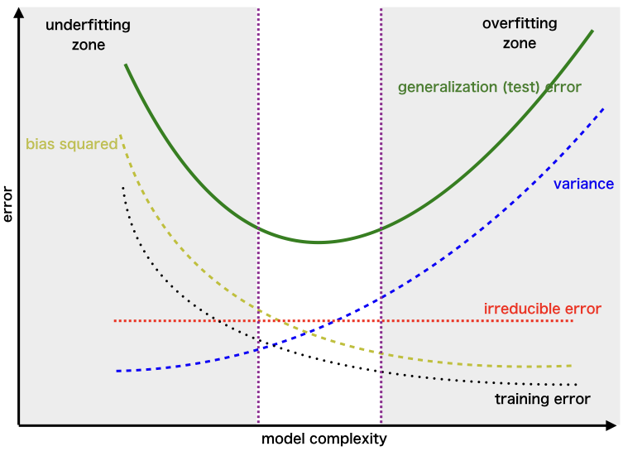
Bias - Variance

Slide 24
Neural network
Use NN as classifier.
Perceptron
Multilayer perceptron - NN

Slide 25
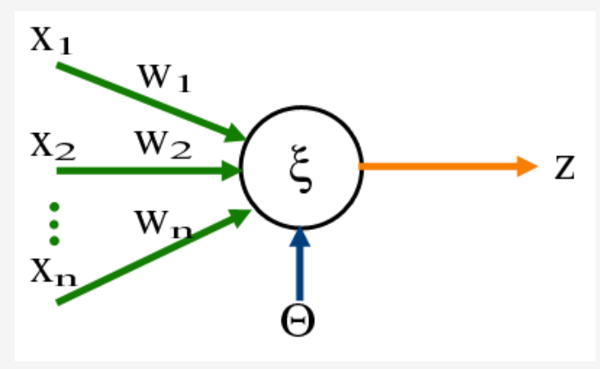
Neural network
Use NN as classifier.
Perceptron
Heavy-side step function

Slide 26
Neural network
Use NN as classifier.
Multilayer perceptron - NN
add more neurons
Each neuron processes inputs independently
A perceptron is a single neuron that takes inputs, weights them, sums them up, and applies an activation function (e.g., the Heaviside function).
It’s used for binary classification and can only separate linearly separable data.
Cant handle non-linear data
How to solve this?

Slide 27
Neural network
Use NN as classifier.
Multilayer perceptron - NN
add more neurons
Each neuron processes inputs independently
A perceptron is a single neuron that takes inputs, weights them, sums them up, and applies an activation function (e.g., the Heaviside function).
It’s used for binary classification and can only separate linearly separable data.
Cant handle non-linear data
How to solve this?
more neurons - multiple perceptrons working together.
Collection of neurons is called a layer

Slide 28
Neural network
Use NN as classifier.
Multilayer perceptron - NN
Input Layer: Receives input data.
Hidden Layers:
Intermediate layers where neurons process input data.
These layers are not visible in the final output but play a crucial role in learning complex patterns.
Output Layer: Produces the final output of the network.
Use NN as classifier.
Multilayer perceptron - NN

Slide 29
Neural network
Use NN as classifier.
Multilayer perceptron - NN
A neural network is simply a series of perceptrons arranged in layers:
Single-Layer Network: a perceptron, with only an input and an output layer.
Function is heavy-side step
Multi-Layer Network:
By adding hidden layers,
the network capture more complex relationships.
Each layer’s output is the next layer’s input.
Sigmoid: Smooth, maps input to values between 0 and 1.
ReLU (Rectified Linear Unit): Allows networks to handle a wider range of values.
Tanh: Maps input to values between -1 and 1.
Use NN as classifier.
Multilayer perceptron - NN

Slide 30
NN overfitting - regularization
Mitigating Overfitting in Neural Networks
1. L1 & L2 Regularization
L2 (Ridge): Adds penalty​, encouraging smaller weights and reducing model complexity.
L1 (Lasso): Adds penalty, promoting sparsity by setting some weights to zero, reducing features.

Slide 31
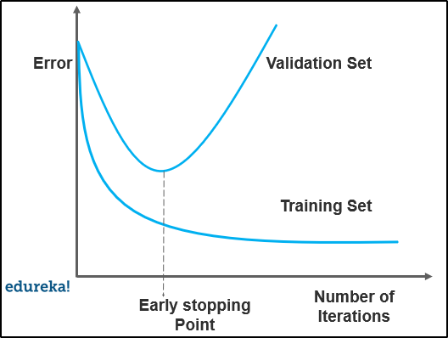
NN - overfitting
Early Stopping
Monitors validation accuracy during training.
Stops training at epoch when validation accuracy plateaus or decreases, preventing overfitting.
from tensorflow.keras.callbacks import EarlyStopping
early_stopping = EarlyStopping(monitor='val_loss', patience=5, restore_best_weights=True)
model.fit(X_train, y_train, validation_data=(X_val, y_val), epochs=100, callbacks=[early_stopping])

Slide 32
NN overfitting - Dropout
What it does:
Dropout is a regularization technique
during training, random neurons in the neural network are "dropped" (set to zero) in each forward pass.
This prevents the network from becoming too dependent on specific neurons, helping to avoid overfitting.
How to use it:
Specify a Dropout layer with a probability, such as 0.5, to indicate that each neuron has a 50% chance of being dropped during training.

Slide 33
NN overfitting - Batch normalization
normalizes the inputs to each layer
stabilize and speed up training
from tensorflow.keras.layers import BatchNormalization
model = Sequential(
[ Dense(128, activation='relu', input_shape=(input_shape,)),
BatchNormalization(),
Dropout(0.5),
Dense(64, activation='relu'),
BatchNormalization(),
Dropout(0.5),
Dense(1, activation='sigmoid') ]
)

Slide 34
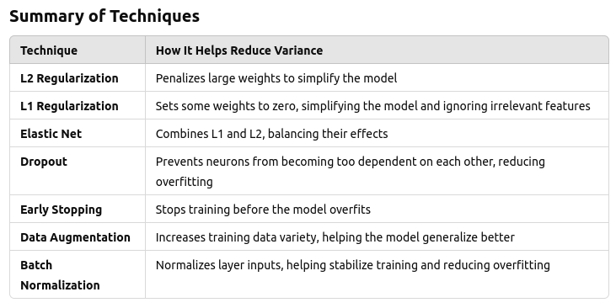
NN overfitting

Slide 35
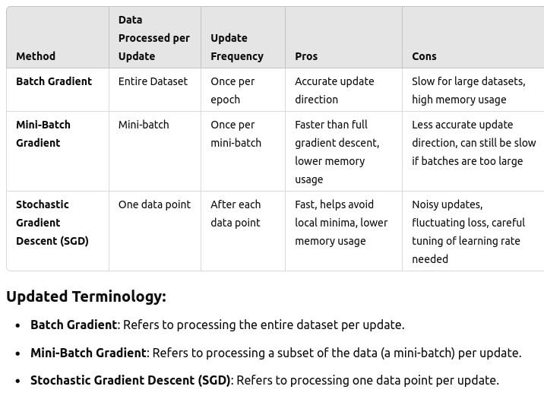
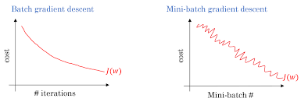
Gradient descent

Slide 36
Gradient descent
https://towardsdatascience.com/batch-mini-batch-stochastic-gradient-descent-7a62ecba642a

Slide 37
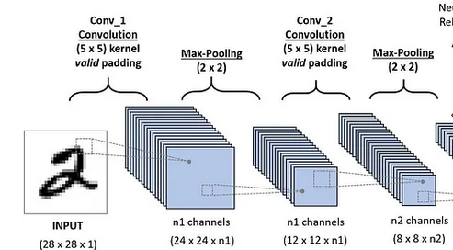
CNN
Convolution layers
Hierarchical Feature Learning:
Initial Layers: The first few convolutional layers learn basic, low-level features like edges, textures, and simple patterns.
Middle Layers: As we stack more layers, the network starts combining these basic features to recognize more complex shapes and patterns.
Deeper Layers: The deepest layers capture even more abstract, high-level features and are often able to recognize object parts or entire objects.

Slide 38
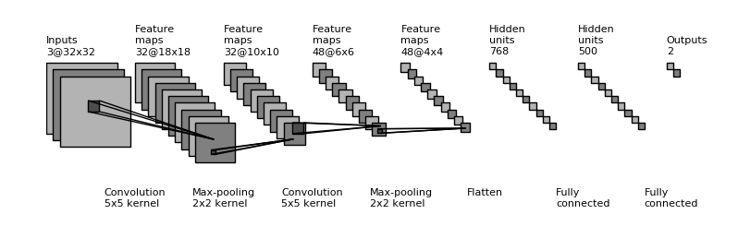

Slide 39
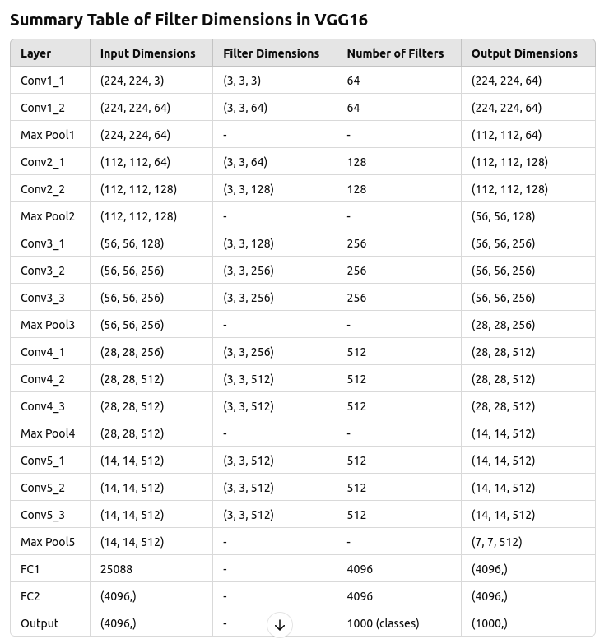
VGG

Slide 40
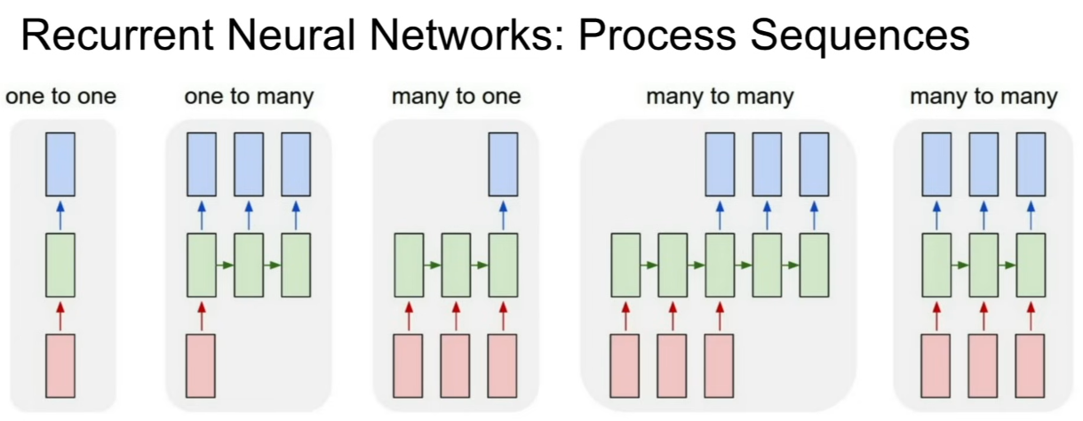
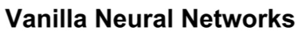
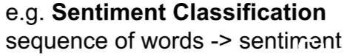
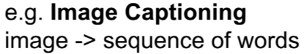
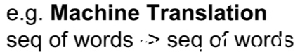

Slide 41
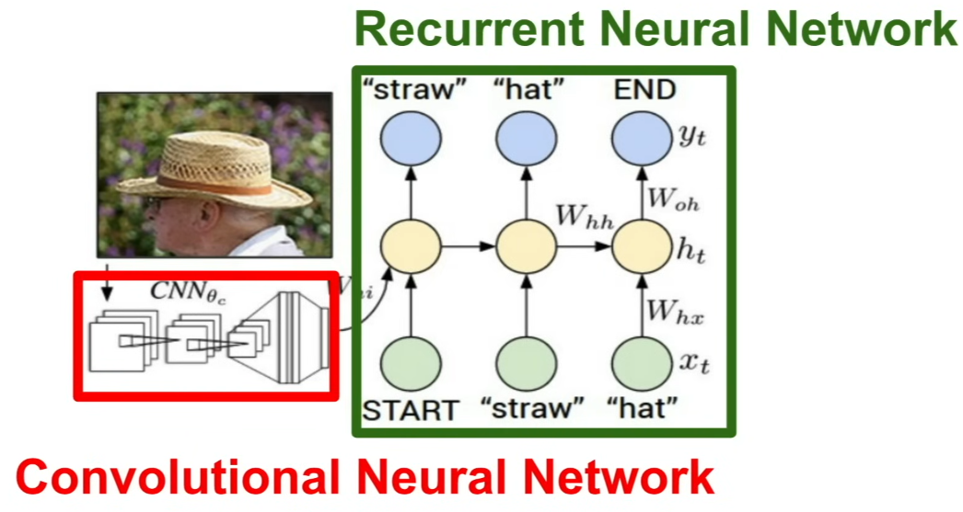
RNN - Image captioning

Slide 42

RNN - unseen data during training

Slide 43
More on RNN
https://cs231n.stanford.edu/slides/2017/cs231n_2017_lecture10.pdf
https://gist.github.com/karpathy/d4dee566867f8291f086
https://towardsdatascience.com/recurrent-neural-networks-rnns-3f06d7653a85

